Slide 1

Benefits of Instagram for business
​

Slide 2
Instagram has over 1.15 billion active users with approximately one billion monthly active users.
90% of Instagram users follow at least one business account. No wonder more than 200 million businesses have a presence on Instagram.
Influencers prefer Instagram due to its convenience. If you hire a well-known influencer, they can spread the word about your brand or product to millions of people in just a few days.

Slide 3

Top 3 benefits
Easy to target audience
Visual storytelling
Make money

Slide 4
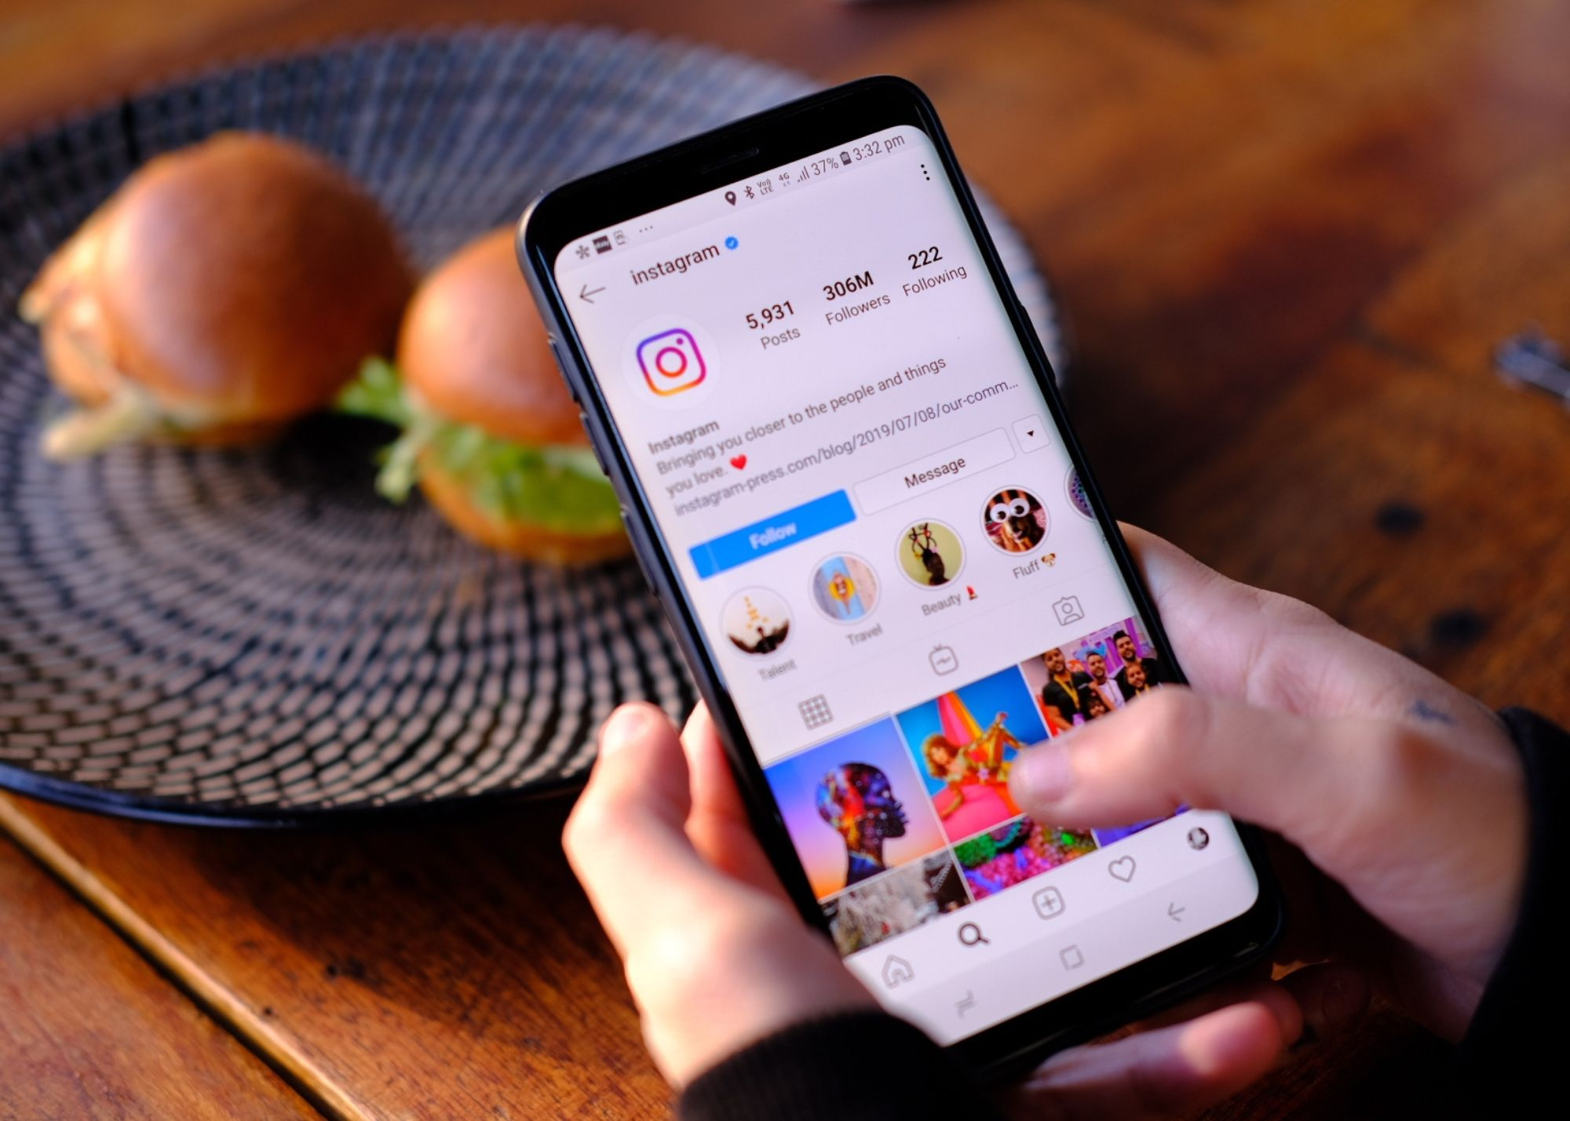
HOW PEOPLE ARE GETTING ATTRACTED TO THIS INSTAGRAM BUSINESS
Instagram offers business profiles
A powerful built-in analytics tool. ...
Promoted posts and advertising. ...
Customers can shop in-app. ...
Swipe-up links in stories. ...
Contact links. ...
It's free. ...
Less personal. ...
Paid advertisement

Slide 5

Summary
Instagram helps businesses effectively engage with customers. With Instagram, you can engage customers daily by having them share feedback and opinions.

Slide 6
Thank you

